Slide 1
Software Tech 1
Capstone Project
By Wade O’Brien

Slide 2
Background Information
My presentation will be on a series of five questions, my EDA, which all relate to the manipulation of images within a dataset. The dataset that I have been provided contains numerous images on different tomato diseases. This dataset has a range of classes such as Bacterial Spot, Leaf Mold, Late Blight, and Powdery Mildew. I will then conclude with my PDA.

Slide 3
Question 1:

Slide 4

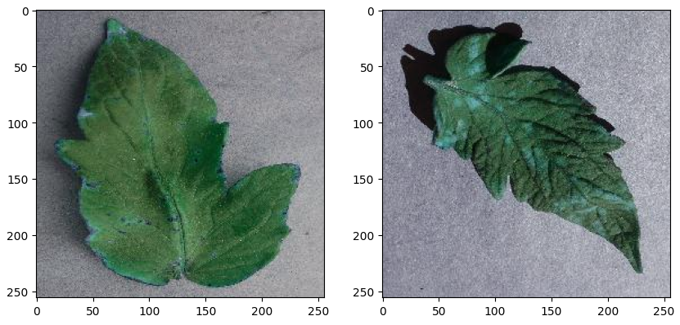
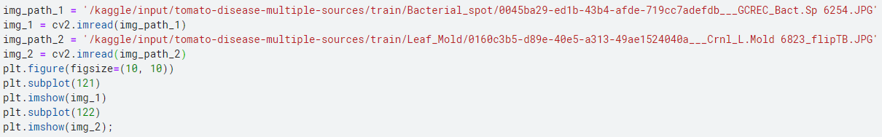
Q1: Can I display the images side by side?
To display anything first I import cv2 and matplotlib
Next, I store the two image file paths as variables and use cv2’s imread method to store the images as variables too.
I use matplotlib to display the two images next to each other.

Slide 5
Question 2:

Slide 6
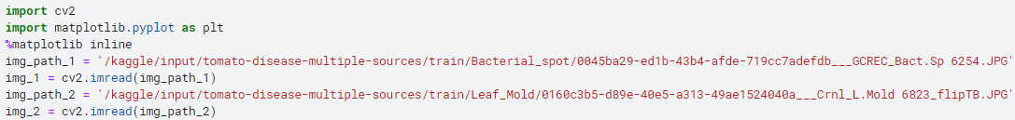
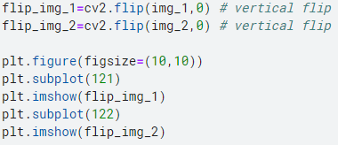
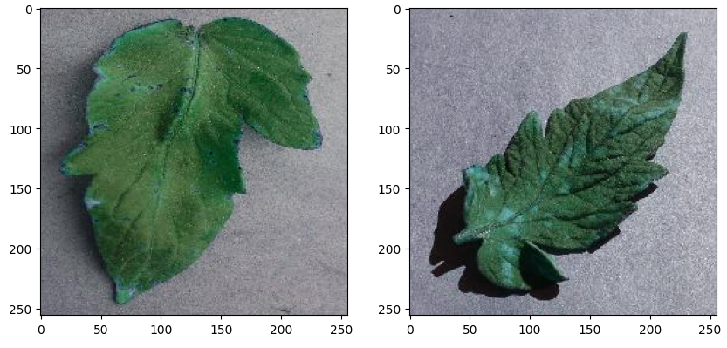
Q2: Can I transform the images?
To transform the images, first I’ll import cv2 and matplotlib, then use cv2’s flip method.
By using a value of 0 for the second parameter of cv2’s flip method the image will be flipped vertically. I then assign the result to a variable so that I can use matplotlib to display them.

Slide 7
Question 3:

Slide 8
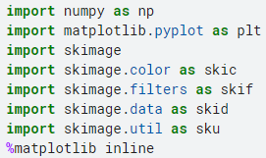
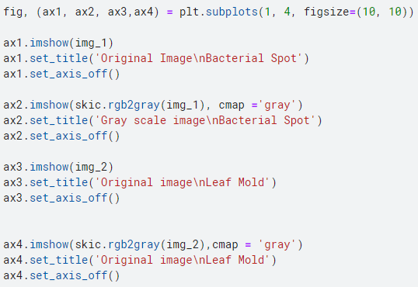
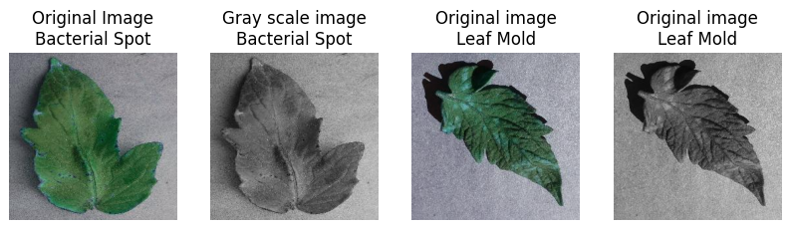
Q3: Can I make the images greyscale?
To display the images in greyscale, first I’ll import a bunch of scikit libraries and use the skimage rgb2gray method.
By inputting the rgb2gray method in place of the image variable of the imshow method and setting the cmap to gray, the image will be converted to greyscale. I then simply used matplotlib to display them alongside the originals as shown below.

Slide 9
Question 4:

Slide 10
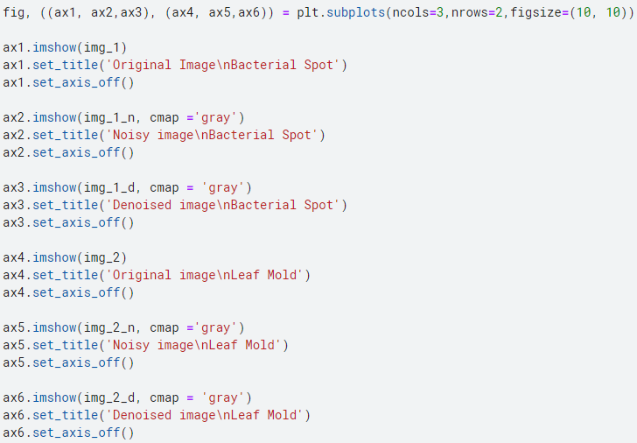
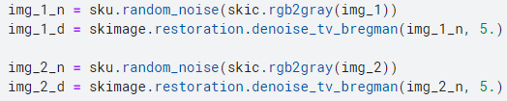
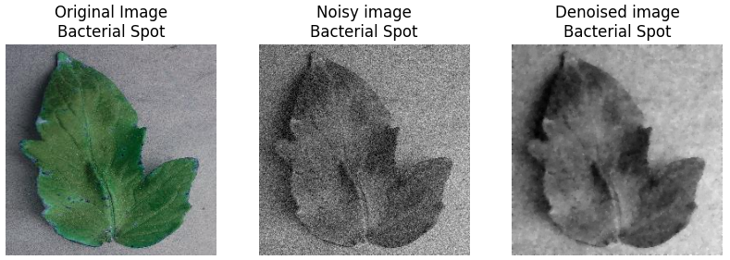
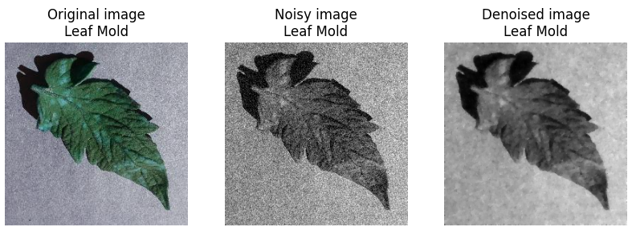
Q4: Can I apply Gaussian noise and denoise to the images?
To apply gaussian noise and denoise to the images, I start by applying rgb2gray to both of the images then run them through the random_noise method. Next, to denoise the images I ran the denoise_tv_bregman method on the images with the noise applied. Finally I plotted each of them with matplotlib.

Slide 11
Question 5:

Slide 12
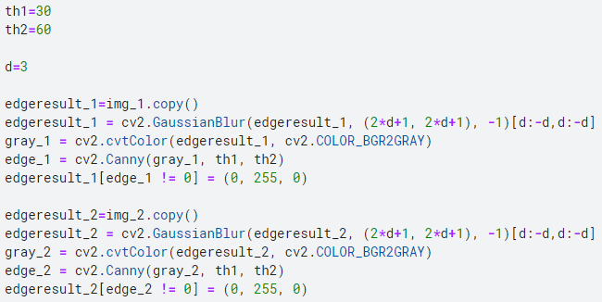
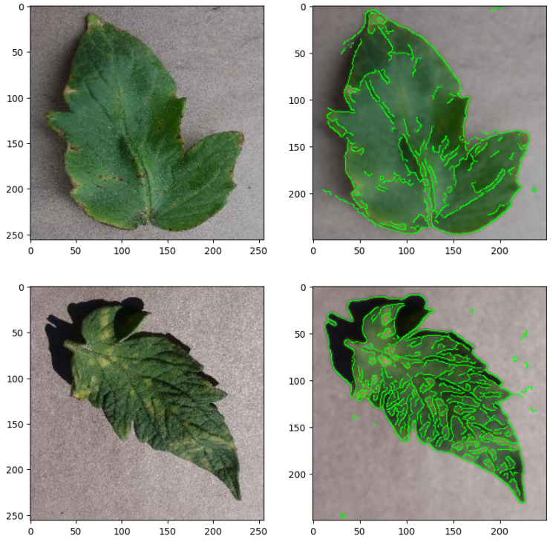
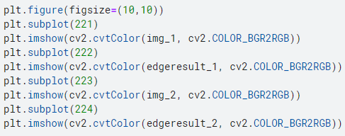
Q5: Can I detect the edges of the images?
To detect the edges of the leaves in the images, I first set two thresholds, with the second being twice as large as the first.
Next I copy the images and run the cv2 GaussianBlur method on the image. I then apply a colour-space conversion to grey on the image, before running the canny edge detection on the image between the two thresholds. Finally the edge’s are coloured green. This happens for both images before using matplotlib to display the four images as shown below.

Slide 13
Stage 2 progress / PDA

Slide 14
Stage 2 progress (as of 11/10)
So far I have downloaded my dataset and selected the two classes, Bacterial Spot and Leaf Mold, which I will be training my AI on. My plan going forward will be to upload these two classes to teachable machine which will train the AI, then download the resultant model. From there I can open it in python and create an output GUI for it.

Slide 15
Thank you!

